Slide 1
Business Analysis & Business Design best practices
Scope of this presentation: This presentation aims at elaborating the Business Analysis & Business Design best practices gathered from various real-life projects I had worked on.

Slide 2
1. Roadmaps to refer back to
Roadmaps help everyone in a project have an idea of how we want to achieve an objective
Updated roadmaps as we progress helps visualize evolution

Slide 3
2. Customer journeys to uncover user's pain points
User centric customer journeys to uncover users pain points ensuring a sophisticated solution fit for purpose.
Say the user wants to check out of an e-Commerce / m-Commerce site,
A very lengthy page to complete personal and payment details is cumbersome.
Resolved by a whizard checkout instead of one lengthy page.

Slide 4
3. Fully clarified assumptions
Fully clarified assumptions help collaborate with business and technology effectively.

Slide 5
4. Unambiguous requirements
Unambiguous requirements help build software solutions that really solve the problem statement.
Ambiguous requirements could lead to building digressed solutions.

Slide 6
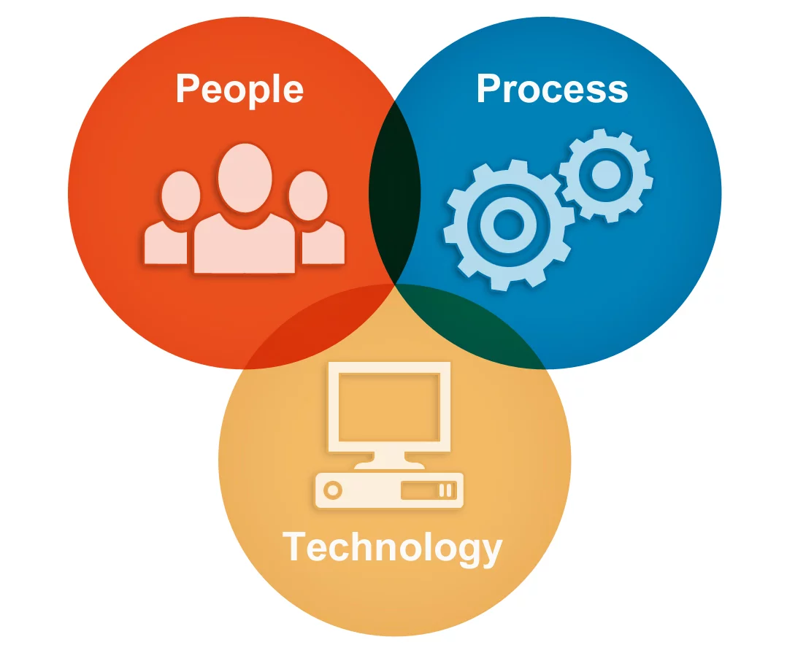
5. Simplify business processes
People process and technology to be taken in to account together to simplify business processes thereby saving cost and time to the organization.

Slide 7
6. Elaborate system behavious in collaboration with dev & test
Collaborate well with dev and test to elaborate system behaviours enabling solutions built are really suitable for purpose

